Slide 1
MAIL SERVER

Slide 2
Presented by :
Manish Malik (12CSS-28)
Mehrab Alam (12CSS-30)

Slide 3

MAIL SERVER
A message transfer agent or Mail transfer agent (MTA) or mail relay is software that transfers electronic mail messages from one computer to another using a client-server application architecture.
An MTA implements both the client (sending) and server (receiving) portions of the SIMPLE MAIL TRANSFER PROTOCOL.
A mail server is a computer that serves as an electronic post office for email. Mail exchanged across networks is passed between mail servers that run specially designed software. .
This software is built around agreed-upon, standardized protocols for handling mail messages and the graphics they might contain

Slide 4


Electronic Mail: Overview
Three major components:
  user agents, mail servers, SMTP
  User Agent
  “mail reader”
  composing, editing, reading mail messages
  e.g., Eudora, Outlook, elm, Netscape Messenger
  Mail Servers
  mailbox contains incoming messages for user
  message queue of outgoing (to be sent) mail messages
  use SMTP protocol between mail servers to send email messages
    client: sending mail server
    “server”: receiving mail server Gmail?
outgoing
message queue
user
agent
user mailbox
mail
server
user
agent
SMTP
mail
server
user
agent
SMTP
SMTP
mail
server
user
agent
user
agent
user
agent

Slide 5
Mail Services
Three major mail services:
  Simple Mail Transfer Protocol
    SMTP
  Post Office Protocol
    POP3
  Internet Mail Access Protocol
    IMAP or IMAP4

Slide 6
SMTP
uses TCP (Transmission Control Protocol )to reliably
transfer email message from client to server, port 25
direct transfer: sending server to receiving server
three phases of transfer
  handshaking (greeting)‏
  transfer of messages
  Closure
command/response interaction
  commands: ASCII text
  response: status code and phrase
messages must be in NVT(Network Virtual Terminal) 7-bit ASCII
We have MIME (Multipurpose Internet Mail Exchange) for transferring non-ASCII data.

Slide 7
What is SMTP?
Simple Mail Transfer Protocol (SMTP) is the standard protocol for sending emails across the Internet.
  SMTP uses TCP port 25 or 2525
  Sometimes you may have problems sending messages
    ISP(Internet service provider) may have closed port 25
    To determine the SMTP server for a given domain name
    MX (Mail eXchange) DNS record is use
Simple Mail Transfer Protocol
  e-mail transmissions across the Internet
  The protocol used today is also known as ESMTP
  Relatively simple text-based protocol

Slide 8
What is SMTP?
Client-Server protocol
  The client transmits an email message to the server
  Either
    . MUA (Mail User Agent),
    - or -
    a relaying server's MTA (Mail Transfer Agents)
  can act as an SMTP client.
Command/response interaction
  commands: ASCII text
  Messages must be in 7-bit ASCII

Slide 9
What is SMTP?
SMTP requires message (header & body) to be in 7-bit ASCII
SMTP server uses CRLF.CRLF to determine end of message
SMTP is a "push" protocol that does not allow one to "pull" messages from a remote server on demand
To do a pull (i.e. receive) a mail client must use POP3 or IMAP

Slide 10
What is SMTP?
After establishing a connection between the sender (the client) and the receiver (the server), the following page shows a legal SMTP session.
  In the following conversation, everything sent by the client is prefaced with
  C: and everything sent by the server
  S:On most computer systems, a connection can be established using the telnet command on the client machine, for example:
    telnet localhost 25

Slide 11
Sample communications
S: 220 ubuntu ESMTP Postfix
C: HELO mydomain.com
S: 250 ubuntu
C: MAIL FROM:<sender@mydomain.com>
S: 250 Ok
C: RCPT TO:<friend@ubuntu>
S: 250 Ok
C: DATA
S: 354 End data with <CR><LF>.<CR><LF>
C: Subject: test message
C: From: sender@mydomain.com
C: To: friend@ubuntu
C:
C: Hello,
C: This is a test.
C: Goodbye.
C: .
S: 250 Ok: queued as 12345
C: QUIT
S: 221 Bye

Slide 12

Which one to use?
Outbound Mail
  SMTP for outbound email
    Port 25 or 2525
Inbound Mail
  POP3 for inbound email
    Port 110
  IMAP for inbound email
    Port 143

Slide 13
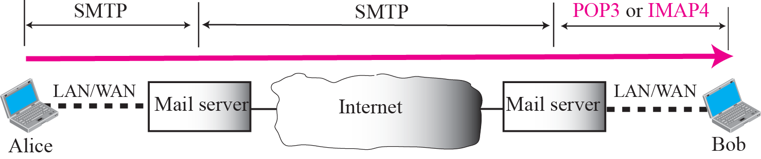
Pop3 and IMAP4

Slide 14

POP Overview
  Local e-mail clients use the Post Office Protocol version 3 POP3
  Retrieves e-mail from a remote server over a TCP/IP connection
Many subscribers to individual Internet service provider e-mail accounts access their e-mail with client software that uses POP3.
POP3 has made earlier versions of the protocol obsolete
POP (informally called POP1 and POP2)
POP almost always means POP3 in the context of e-mail protocols

Slide 15

POP Overview
The design of POP3 and its procedures supports end-users with intermittent connections (such as dial-up connections)
  Allows users to retrieve e-mail when connected
  View and manipulate the retrieved messages without needing to stay connected
Although most clients have an option to leave mail on server, e-mail clients using POP3 generally:
  Connect
  Retrieve all messages
  Store them on the user's PC as new messages
  Delete them from the server
  Disconnect.

Slide 16
POP Overview
The fundamental difference between POP3 and IMAP4:
  POP3 offers access to a mail drop
    Mail exists on the server until it is collected by the client
    If the client leaves some or all messages on the server
  In contrast, IMAP4 offers access to the mail store
    The client may store local copies of the messages
    These are considered to be a temporary cache
    Whether using POP3 or IMAP to retrieve messages:
  E-mail clients are commonly categorized as either POP or IMAP clients, but in both cases the clients also use SMTP
  POP3 that allow some clients to transmit outbound mail via POP3

Slide 17
POP Overview
In contrast, the newer, more capable Internet Message Access Protocol (IMAP) supports both connected and disconnected modes of operation.
  E-mail clients using IMAP generally leave messages on the server until the user explicitly deletes them.
This and other fact of IMAP operation allow multiple clients to access the same mailbox
Most e-mail clients support either POP3 or IMAP to retrieve messages
  Few Internet Service Providers (ISPs) support IMAP

Slide 18
IMAP
Internet Message Access Protocol
  Commonly known as IMAP or IMAP4
  An application layer Internet protocol
    Operates on port 143
    Allows a local client to access e-mail on a remote server
  Previously called Internet Mail Access Protocol, Interactive Mail Access Protocol (RFC 1064), and Interim Mail Access Protocol)
Current version is IMAP version 4 revision 1
IMAP4 and POP3 are the two most prevalent Internet standard protocols for e-mail retrieval
  Allows interoperability with other servers and clients

Slide 19
IMAP
Support for the Internet standard protocols
  Allows other e-mail clients to access these servers
  Allows the clients to be used with other servers
  E.g. Qualcomm's Eudora or Mozilla Thunderbird
IMAP is often used in large networks
  For example, a college campus mail system.
IMAP allows users to access new messages
  The mail is stored on the network
With POP3, users either
  download the e-mail to their computer
  access it via the web.
  take longer than IMAP
  must either download any new mail or "refresh" the page to see the new messages.

Slide 20

Difference between
POP3 and IMAP
POP3 - Post Office Protocol | IMAP - Internet Messaging Access Protocol
You can use only one computer to check your email | You can use multiple computers to check your email
Your mails are stored on the computer that you use | Your mails are stored on the server
Outgoing email is stored locally on your PC | Outgoing email is filtered to a mailbox on the serve
POP3 works by reviewing the inbox on the mail server, and downloading the new messages to your computer. IMAP downloads the headers of the new messages on the server, then retrieves the message you want to read when you click on it.
When using POP3, your mail is stored on your PC. When using IMAP, the mail is stored on the mail server. Unless you copy a message to a "Local Folder" the messages are never copied to your PC.

Slide 21

INSTALLATION &
CONFIGURATION
Packages
apt-get install postfix
apt-get install dovecot-common dovecot-pop3d dovecot-imapd
apt-get install mailutils
OR (one line)
apt-get install postfix dovecot-common
dovecot-pop3d dovecot-imapd mailutils
If u are not superuser add sudo

Slide 22
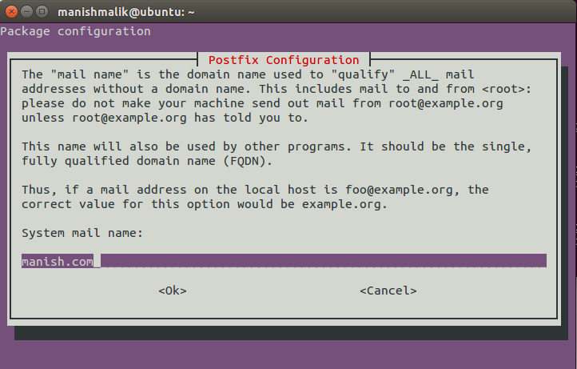
Postfix Installation

Slide 23

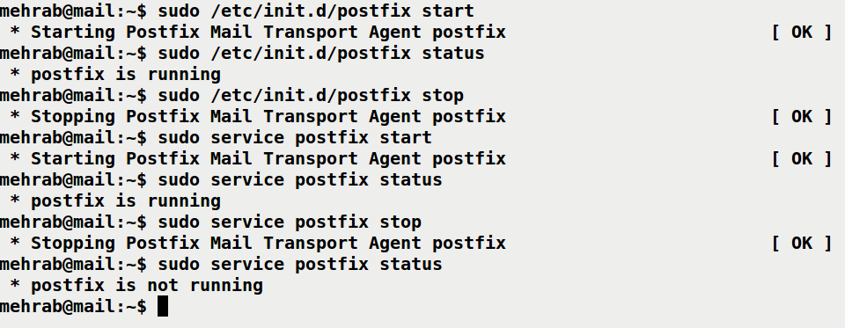
HOW TO CHECK INSTALLATION WORKING OR
NOT
Checking for POSTFIX
/etc/init.d/postfix <options>
OR
service postfix <options>
<options> :: start status stop reload restart

Slide 24
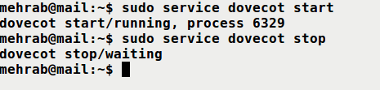
Cont….
For DOVECOT
Replace postfix with dovecot

Slide 25
POSTFIX AND CONFIG FILES
Postfix uses SMTP
Path of postfix config files cd /etc/postfix/
Config files i am looking for
1. main.cf
2. aliases
3. transport
NOTE: aliases and transport files may or may not be present
If not present first create using touch command or other way
example. touch aliases transport

Slide 26
Contd…..
First we see aliases file
Alias means Assumed name or alternative name. It’s actually like a mailing list.
Format of aliases file
user1: user1, user2
user3: user4
Explanation:
line 1
All mails sent to user1 should be received by user2 and user1.
line 2
All mails sent to user4 should be received by user4 only.

Slide 27
Contd…..
After editing aliases run below command
postalias aliases
postalias command creates or queries one or more Postfix alias
databases, or updates an existing one.
transport file
Default :: This file is Empty
Format of transport file
Domain local:
.Domain local:

Slide 28
Contd…..
Lets take example to understand transport file format
linuxlab.com local:
.linuxlab.com local:
Explanation:
Mails destined to domain linuxlab.com are defined
to be delivered locally without any DNS queries.
After editing transport run below command
postmap transport
postmap hash:/etc/postfix/transport

Slide 29
Contd…..
main.cf file
Format of main.cf file
parameter = value
Parameters
# This is my host name #
myhostname = mail.mehrab.com
## alias definitions ##
alias_maps = hash:/etc/postfix/aliases
alias_database = hash:/etc/postfix/aliases

Slide 30
Contd…..
# transport defination
transport_maps = hash:/etc/postfix/transport
# myorigin name
# give path or simply write domain name eg. xyz.com
myorigin = /etc/mailname
mydestination = mehrab.com, mail.mehrab.com, localhost.mehrab.com, localhost, hash:/etc/postfix/transport
mynetworks = 127.0.0.0/8 [::ffff:127.0.0.0]/104 [::1]/128
inet_interfaces = all
#inet_localhost

Slide 31
Contd…..
After doing all this reload or restart postfix
service postfix restart
You can also verify using netstat
netstat –nat
Location of log file /var/log/mail.log

Slide 32
POP/IMAP (dovecot) CONFIG
file path :: /etc/dovecot/conf.d/
Config file I am looking for
10-mail.conf
# the location of the mailbox is specified in 'mbox' format
mail_location = mbox:~/mail:INBOX=/var/mail/%u
# dovecot is granted necessary permission to read/write user mailboxes
mail_privileged_group = mail

Slide 33
After editing reload or restart dovecot
service postfix dovecot
You can also verify using netstat
netstat –nat

Slide 34
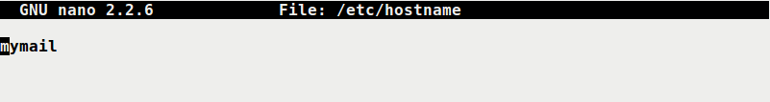
Hostname ,Hosts and Add user
Hostname path /etc/hostname
Hosts /etc/hosts
For Adding User
sudo adduser <username>

Slide 35
REFERENCES:
Behrouz A. Forouzan, TCP/IP Protocol Suites, Tata McGraw Hill Edition
James F. Kurose and Keith W. Ross, Computer Networks, A Top Down Approach Fifth Edition
http://www.cisco.com/public/support/tac/documentation.html
http://www.redhat.com/docs
http://home.iitk.ac.in/~navi/sidbinetworkcourse
And mostly from Wikipedia and Google search.

Slide 36
Now Its Time see DEMO

Slide 37

Thank You

